Slide 1
UNIT I – BASICS OF SDN
UNIT I – SESSION 1
SESSION 9
Configuration and Extensibility
Architecture
Hybrid Approaches
Ships in the Night
Dual Function Switches
Reference: Ref. 2, Ch. 3 (Page. 57 to Page 69)

Slide 2
1.Config and Extensibility
The of-config protocol was originally designed to set OpenFlow related information on the network element (of-config 1.0).
The protocol is structured around XML schemas, Yang data models, and the NETCONF protocol for delivery.
YANG is a data modeling language used to model configuration, state data, and administrative actions manipulated by the NETCONF protocol
Proposals to extend of-config can come from within the Config-Mgmt Working Group or from other groups (e.g., FAWG, Transport).
As of version 1.1 of of-config, the standard decouples itself from any assumptions that an operator would run FlowVisor (or a similar, external slicing proxy) to achieve multiple virtual switch abstractions in a physical switch.
This changes the working model to one in which the physical switch can have multiple internal logical switches, as illustrated in Figure.

Slide 3
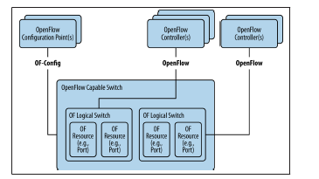

Slide 4
Config and Extensibility
Using of-config version 1.1, in addition to controllers, certificates, ports, queues, and switch capabilities operators can configure some logical tunnel types (IP-in-GRE, NV GRE, VX-LAN).
This extension requires the support of the creation of logical ports on the switch. Proposals exist to expand of-config further in the areas of bootstrapping and to expand the abilities of the of-config protocol in version 1.2 (see Figure) to support even more switch/native functionality (e.g., the ability to configure a local/native OAM protocol daemon has been proposed as an extension).

Slide 5
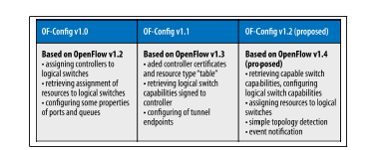

Slide 6
2.Architecture
OpenFlow provides a standardized southbound protocol. The southbound interface is the communication channel between the OpenFlow controller and the network devices (switches or routers) that support the OpenFlow protocol. It allows the controller to send instructions to the forwarding plane of these devices, such as forwarding rules and flow entries.
The east/west state distribution on most available controllers is based on a database distribution model, which allows federation of a single vendor’s controllers but doesn’t allow an interoperable state exchange.
The Architecture Working Group is attempting to address this at least indirectly— defining for SDN a general SDN architecture.
The ONF has a history of marrying the definition of SDN and OpenFlow.
RESTful API:The controller may provide a RESTful API (Representational State Transfer) that allows external applications and systems to interact with it programmatically.

Slide 7
Most OpenFlow controllers (Figure) provide a basic set of application services: path computation (Path computation refers to the process of determining the optimal or suitable paths through a network for data transmission), topology (determined through LLDP, which limits topology to layer 2), and provisioning.
Path computation is a fundamental task in networking that involves determining the optimal routes for data packets to traverse from a source to a destination within a network.
Provisioning in the context of networking refers to the process of setting up, configuring, and allocating resources required for network services or applications to function properly
To support of-config, they need to support a NETCONF driver.
GUI (Graphical User Interface):Some OpenFlow controllers include a graphical user interface that provides network administrators with a visual representation of the network topology, flow statistics, and configuration options..

Slide 8
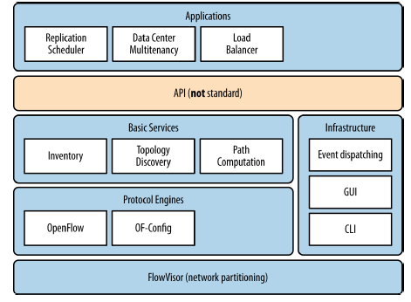
OpenFlow controller components

Slide 9
3.Hybrid Approaches
The ONF did spawn a Hybrid Working Group. The group proposed architectures for a Ships in the Night (SIN) model of operation and an Integrated Hybrid model.
It describe a scenario where two communication entities, typically nodes or devices, operate independently without direct interaction or coordination. In this model, the entities communicate with each other, but their communication occurs asynchronously, without any synchronization or coordination.
Ships in the night (SIN) is a switch hybridisation approach anchored on the idea that each side of the switch (Open Flow and conventional) thinks it is alone, with no cooperation or coordination oftheir actions. This means that there is no interaction of OpenFlow and legacy control-planes, andthe respective data-planes are also isolated.
The board only accepted the recommendations of the SIN model.
The Integrated Hybrid model spawned a series of questions around security and the inadvertent creation of a hybrid network.
Assuming a controlled demarcation point is introduced in the network element (between the OpenFlow and native control planes), the security questions revolve around how the reserved ports (particularly CONTROLLER, NORMAL, FLOOD, and LOCAL) could be exploited to allow access to native daemons on the hybrid (applications on the controller or OpenFlow ports spoofing IGP peers and other protocol sessions to insert or derive state) or the native network.

Slide 10
The security perimeter expands in the case of an unintended connection that creates a hybrid network.
This occurs when one end of an external/non-loopback network link is connected to an OpenFlow domain and the other end to a native domain.
Ships-in-the-Night setup: All routers run two routing processes,
The SDN controller can easily implement load-balancing at high data rates by justdirecting different flows to different hosts

Simplified traffic isolation

Slide 11
3.1.Ships in the Night
The Ships in the Night proposition assumes that a port (physical or logical) can only be used for OpenFlow or native, but not both (see Figure).
The focus of SIN was on:
• Bounding the allocated resources of the OpenFlow process and such that they couldn’t hamper the operation of the native side (and the reverse).
Suggestions included the use of modern process level segregation in the native host OS (or by virtualization).
Avoiding the need to synchronize state or event notifications between the control planes.
Strict rules for the processing of flows that included the use of the LOCAL, NOR‐ MAL, and FLOOD reserved ports.

Slide 12
Ships in the Night
SIN expands the preceding ONF definition of hybrid (as reflected in the definition of NORMAL).
The SIN model allowed port segregation by logical port or VLAN and recommended the use of MSTP(Multiple Spanning Tree Protocol) for spanning tree in such an environment (a step that is actually necessary for certain types of integrated hybrids).
Lastly, SIN pointed out the ambiguities in the interactions of the reserved ports and the looseness of the port delegation model as potential areas of improvement for a SIN hybrid

Slide 13
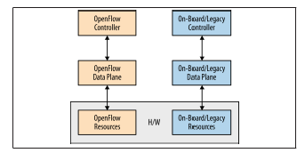
SIN architecture

Slide 14
3.2.Dual Function Switches
Dual-function switches in Software-Defined Networking (SDN) architectures are network devices that perform both traditional switching functions and SDN-controlled forwarding. These switches have the capability to operate in two modes: traditional mode, where they function like conventional switches with distributed control planes, and SDN mode, where they are controlled by a centralized SDN controller.
One of the existing/deployed models of integration is to integrate the OpenFlow domain with the native domain at the control level (e.g., RouteFlow).
Unlike the integrated hybrid, this purposely builds a hybrid network.
The general concept behind this approach is to run a routing stack on a virtual host and bind the virtual ports on the hypervisor vswitch in that host to physical ports on associated OpenFlow switches.
Through these ports, the virtual router forms IGP and/ or BGP adjacencies with the native network at appropriate physical boundary points by enabling the appropriate protocol flows in flow tables of the boundary switches.

Slide 15
Dual Function Switches
The virtual router then advertises the prefixes assigned to the OpenFlow domain through appropriate boundary points (appearing to the native network as if they were learned through an adjacent peer).
Additionally, (by using internal logic and policies) the virtual router creates flow rules in the OpenFlow domain that direct traffic toward destination prefixes learned from neighbors in this exchange using flow rules that ultimately point to appropriate ports on the boundary switch.
Drawback of this hybrid design is that flow management and packet I/O take place serially on a common TCP session, which brings the design back around to the problems that needed to be addressed in the traditional distributed control plane: blocking, control packet I/O, latency, queue management, and hardware programming speed.

Slide 16
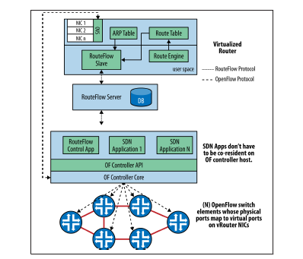
RouteFlow architecture

Slide 17
The tools we have at hand to form an integrated hybrid connection (in the OpenFlow protocol and the native protocols on the same device) are tables and interfaces.
A table-based solution could be crafted that uses the GoToTable semantics of OpenFlow to do a secondary lookup in a native table.
Today, OpenFlow has no knowledge of tables other than its own and no way to acquire this knowledge.
A solution could be crafted that allows the discovery of native tables during session initialization.

Slide 18
There currently are unofficial, interface-based solutions to achieve bidirectional flow between domains.
The most common is to insert a layer 3 forwarding artifact in the OpenFlow switch domain.
That artifact can then be leveraged through a combination of NORMAL behavior, DHCP, and ARP, such that end stations can discover a forwarding gateway device in an OpenFlow domain.
The NORMAL logical port is an egress-only port on the OpenFlow side, so flowmods to control the traffic in the reverse direction are not possible.
Further, some administrators/ operators do not like to use the NORMAL construct for security reasons.

Slide 19
It is possible to create rules directly cross-connecting a layer 3 artifact with OpenFlow controlled ports to allow ingress and egress rules, if we move forward with some extension to the interface definition that allows us to tag the interface as a layer 3 forwarder or native port (the semantics are our least concern).
For example, in the Junos OS (Juniper Networks), there is a construct called a logical tunnel.
This construct can have one end in the OpenFlow domain and one in any routing domain on the native side.
For an operator, this provides a scalable, transparent hybrid solution, but the only tag the operator can hang on the port (to discover its dual nature) is its name (which is unfortunately unique to Juniper Networks).

Slide 20
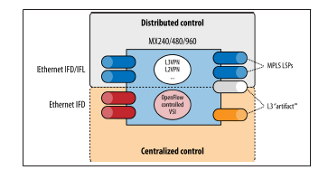
Juniper Networks’ integrated hybrid proposal

Slide 21
An interface-based solution would then require the following:
At minimum, an extension to port description to tag it as a native artifact (an access point between domains), the nature of the domains (e.g., IP/MPLS) and the routing-instances that they host. These attributes can be exchanged with the vendor agent during port-status message or in Features reply message, as part of port-info.
The vendor agent should implement any MAC-related functionality required for bidirectional traffic flow (e.g., auto-associate the MAC of the artifact with any pre‐ fixes assigned to or point to the artifact in the native table).
The vendor agent should support OpenFlow-ARP-related functionality so that devices in the OpenFlow domain can discover the MAC of the artifact.

Slide 22
An interface-based solution would then require the following:
The native port can be implemented as an internal loopback port (preferable) or as an external loopback (i.e., a symmetric solution is preferred over an asymmetric solution).
It will be preferable if certain applications, such as topology discovery by LLDP, exclude the native artifacts/ports. (This is a prescribed operational behavior.)

